Slide 1
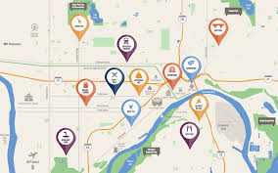


Capstone Project
The Battle of Neighborhoods

Slide 2

OBJECTIVE
¿It's possible to compare neighborhoods of 5 multicultural cities (London, Sydney, Paris, Amsterdan and San Francisco) in order to find groups of neighborhoods that are similar according to similarities in the categories of businesses that are in them?

Slide 3

Data
The data used for resolve the problem is:
Foursquare dataset
Bussiness geo location
Category
Name
Neigbourhoods geo location data from http://insideairbnb.com/get-the-data.html
The features that were used from the data are:
Neigbourhood Geo Location
Neigbourhood Name

Slide 4
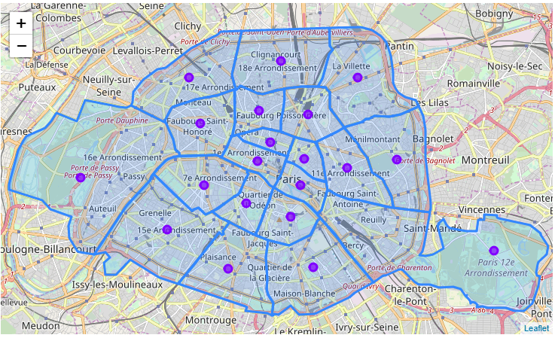
Methodology
For modeling, the k-means algorithm were used in order to identify groups of neighborhoods similar to each other in the distribution of categories of places that are in their surroundings.
The calculation of the center of each neighborhood was made using the shapely library and a test of the data was conducted with the city of Paris

Slide 5
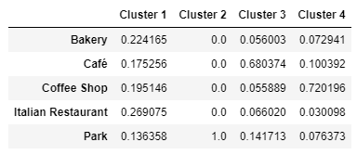
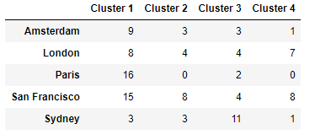
Results
Proportion of venue categories for each cluster
Number of neighborhoods for city for cluster
Cluster 1 has a great variety of categories of venues. Cluster 2 corresponds to neighborhoods with 100% of parks. Cluster 3 is more represented by neighborhoods that own cafes and parks, while Cluster 4 by coffee shops and cafes.

Slide 6
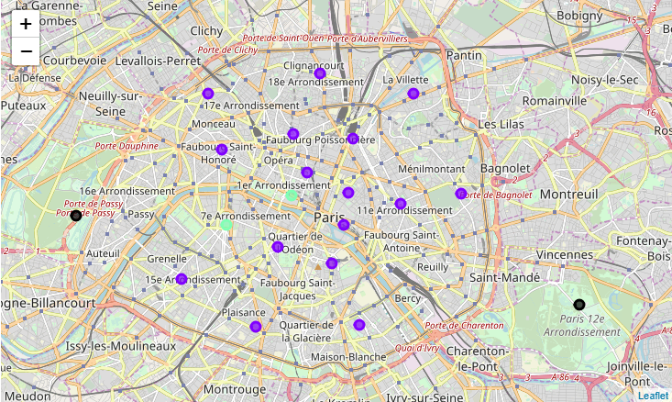
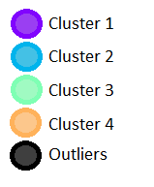
Results: Paris
Clusters distribution:

Slide 7
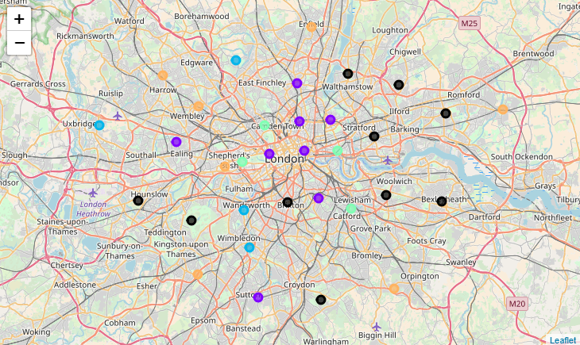
Results: London
Clusters distribution:

Slide 8
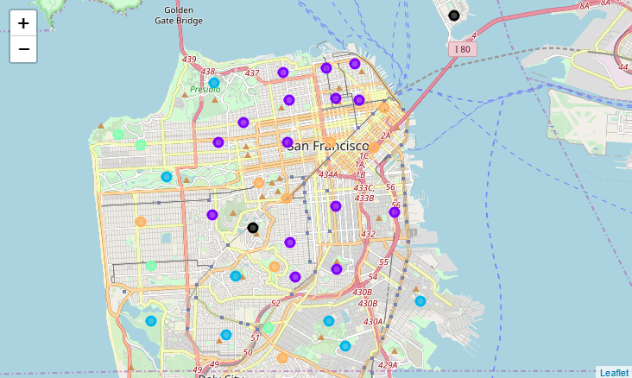
Results: San Francisco
Clusters distribution:

Slide 9
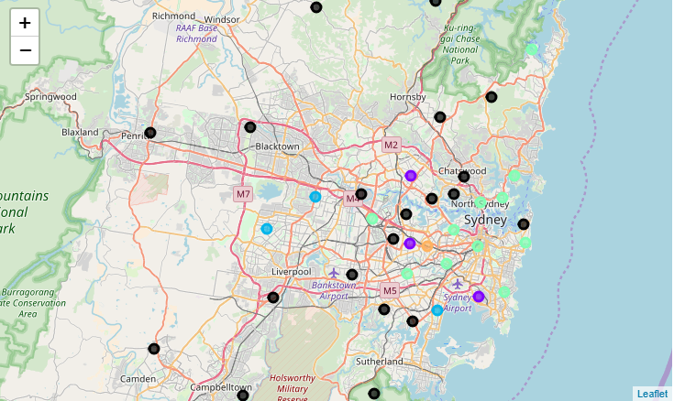
Results: Sidney
Clusters distribution:

Slide 10
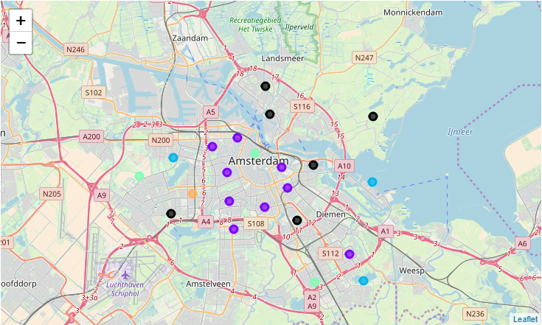
Results: Amsterdam
Clusters distribution:

Slide 11

Conclusions
Almost 100% of the neighborhoods of Paris belong to Cluster 1, this means that Paris has a very good variety of categories of venues.
Sydney is the city with the largest number of outliers, allowing us to conclude that it is the most different city from the other cities evaluated.
London and San Francisco have a very similar distribution of neighborhoods belonging to the different clusters, although London is the second with the highest number of outliers.
Likewise Amsterdam is very similar to Sydney with respect to the distribution of clusters.

